Slide 1

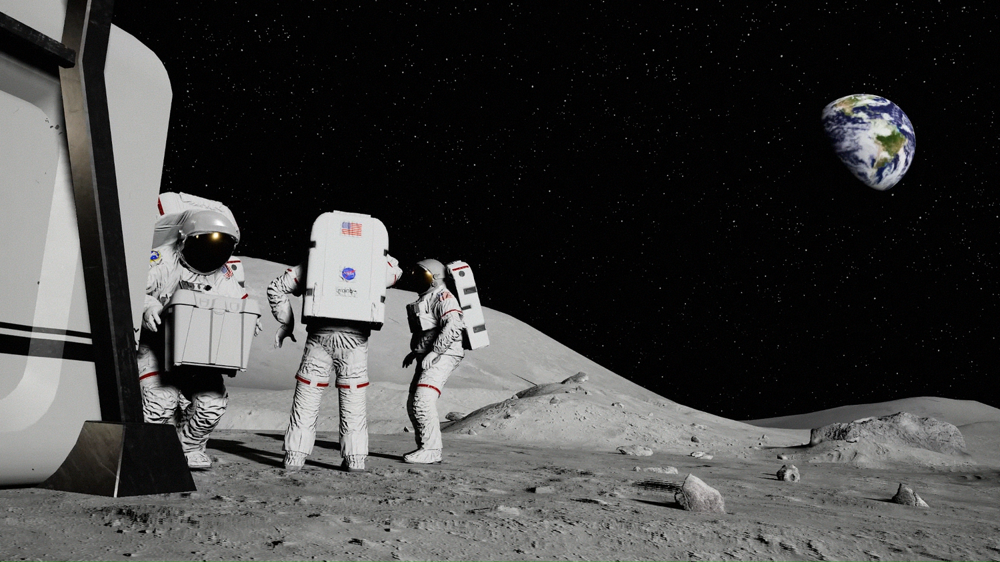
In-Space Cryogenic
Propellant Storage
Team 512
Anna Gilliard | Liam McConnell | Samantha Myers | Brandon Young

Slide 2




Team Introductions
Anna Gilliard
Fluids Engineer
Liam McConnell
Cryogenics Engineer
Samantha Myers
Controls Engineer
Brandon Young
Materials Engineer
Anna Gilliard

Slide 3


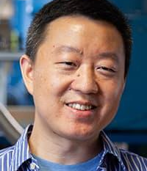
Sponsor and Advisor
Rachel McCauley
NASA Marshall Space Flight Center
Travis Belcher
NASA Marshall Space Flight Center
Wei Guo
FAMU-FSU College of Engineering
Anna Gilliard

Slide 4

Project Objective
The objective of this project is to design a storage tank for cryogenic propellant that increases storage time, reduces fuel loss, and reduces heat transfer.
Anna Gilliard
Summary
Design Update
Testing
Timeline
Current Work

Slide 5






Key Goals
Anna Gilliard
Summary
Design Update
Testing
Timeline
Current Work

Slide 6
Key Goals
Maintain temperature
Anna Gilliard
Summary
Design Update
Testing
Timeline
Current Work

Slide 7
Key Goals
Maintain pressure
Maintain temperature
Anna Gilliard
Summary
Design Update
Testing
Timeline
Current Work

Slide 8
Key Goals
Maintain pressure
Maintain temperature
Reduce fuel loss
Anna Gilliard
Summary
Design Update
Testing
Timeline
Current Work

Slide 9
Key Goals
Maintain pressure
Reduce heat transfer
Maintain temperature
Reduce fuel loss
Anna Gilliard
Summary
Design Update
Testing
Timeline
Current Work

Slide 10
Key Goals
Maintain pressure
Reduce heat transfer
Maintain temperature
Reduce fuel loss
Develop a prototype
Anna Gilliard
Summary
Design Update
Testing
Timeline
Current Work

Slide 11




Assumptions
Withstands Earth, space, and lift-off conditions
Test with liquid nitrogen
Lunar mission of two weeks
Anna Gilliard
Summary
Design Update
Testing
Timeline
Current Work

Slide 12
Critical Targets and Metrics
Anna Gilliard
Summary
Design Update
Testing
Timeline
Current Work

Slide 13
Critical Targets and Metrics
Maintain temperature of 77 K
Anna Gilliard
Summary
Design Update
Testing
Timeline
Current Work

Slide 14
Critical Targets and Metrics
Maintain temperature of 77 K
Maintain structural integrity for two weeks
Anna Gilliard
Summary
Design Update
Testing
Timeline
Current Work

Slide 15
Critical Targets and Metrics
Maintain temperature of 77 K
Maintain structural integrity for two weeks
Maintain pressure of ~30 psi
Anna Gilliard
Summary
Design Update
Testing
Timeline
Current Work

Slide 16
Concept Generation
All high-fidelity concepts are assuming double-shell, pill shaped tank.
Anna Gilliard
Summary
Design Update
Testing
Timeline
Current Work

Slide 17
Concept Generation
Multi-Layer Insulation
All high-fidelity concepts are assuming double-shell, pill shaped tank.
Anna Gilliard
Summary
Design Update
Testing
Timeline
Current Work

Slide 18
Concept Generation
Multi-Layer Insulation
Ceramic Supports
All high-fidelity concepts are assuming double-shell, pill shaped tank.
Anna Gilliard
Summary
Design Update
Testing
Timeline
Current Work

Slide 19
Concept Generation
Multi-Layer Insulation
Ceramic Supports
Film Reflecting Radiation
All high-fidelity concepts are assuming double-shell, pill shaped tank.
Anna Gilliard
Summary
Design Update
Testing
Timeline
Current Work

Slide 20
Original Design
Double-shell, pill shaped tank with MLI, vacuum between layers, reflective layer on the outside surface
Liam McConnell
Summary
Design Update
Testing
Timeline
Current Work
Notes:
This model based mostly on conclusions made by other researchers through testing

Slide 21
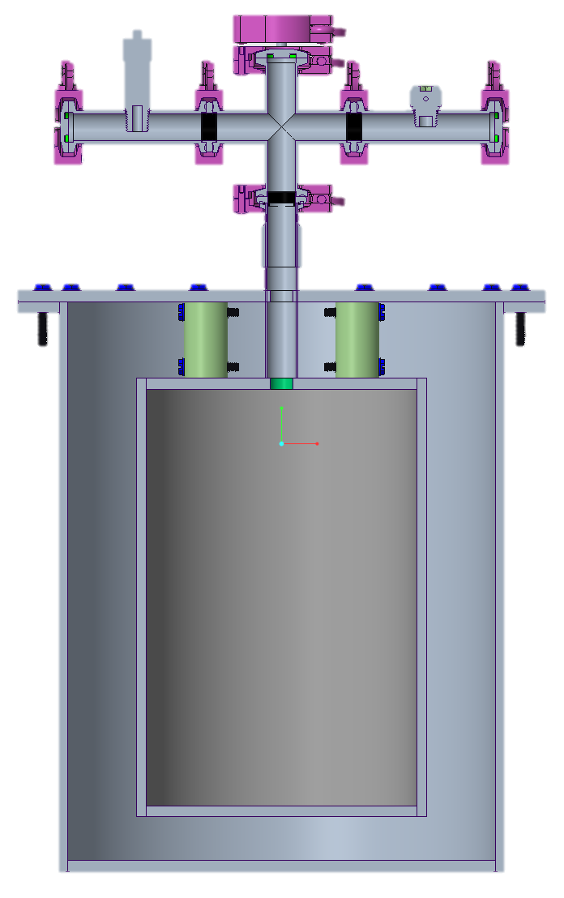
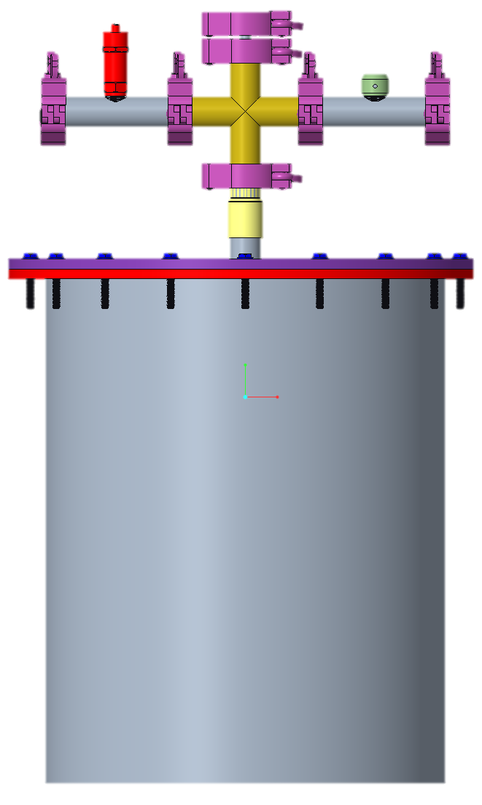
Current Prototype Design
Clamps
Cross Valve
Pressure Relief Valve
Vent
Stainless Steel Pipes
Top Flange
Bolts
Top Flange
G10-CR
Inner and Outer Tanks
Sectioned View
Front View
Liam McConnell
Summary
Design Update
Testing
Timeline
Current Work

Slide 22
Current Prototype Design
Prototype Dimensions
Outer tank diameter: 10.125 in.
Outer tank height: 13 in.
Inner tank diameter: 6.625 in.
Inner tank height: 10 in.
Sectioned View
Front View
Liam McConnell
Summary
Design Update
Testing
Timeline
Current Work

Slide 23
Design Comparison
Liquid Nitrogen
Flat Endcaps
Active Vacuum
Stainless Steel 304
Volume of ~6 gal
Foam Insulation
Liquid Hydrogen
Spherical Endcaps
Sealed Vacuum
Aluminum 2219
Volume of ~300,000 gal
MLI
Prototype
Final Design
G10-CR Supports
Reflective Outer Layer
Liam McConnell
Summary
Design Update
Testing
Timeline
Current Work

Slide 24
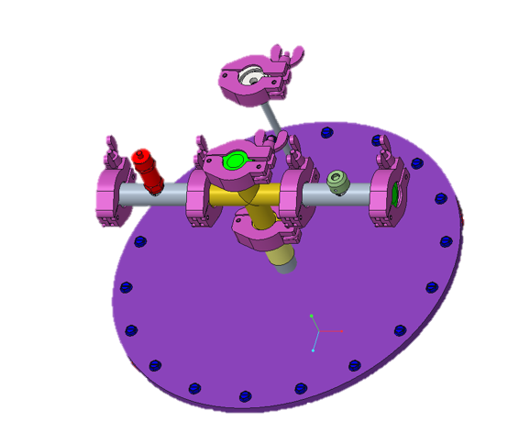
Testing Procedure
1. Open all end caps
2. Fill tank with line through port
3. Close fill port and end caps
4. Record mass flow rate from vents and record mass every 8 hours
Liam McConnell
Summary
Design Update
Testing
Timeline
Current Work

Slide 25
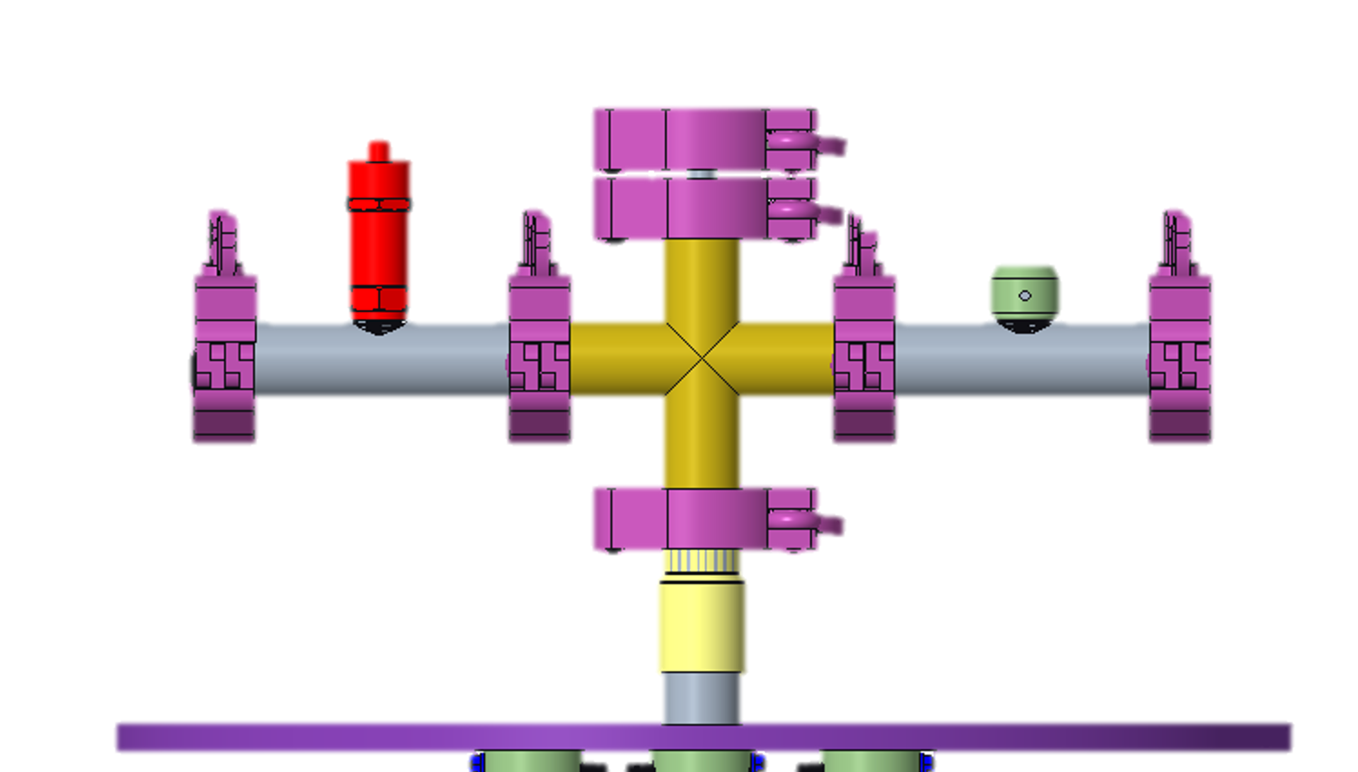
Testing Procedure
Recording Mass Flow Rate
  Flowmeter
  Graduated cylinder and water displacement
  Weight of tank
Recording Mass of Fluid
  Scale
Liam McConnell
Summary
Design Update
Testing
Timeline
Current Work

Slide 26

Purchasing
Inner tank
Outer tank
Vacuum connection
G10-Cr pipe
Pressure relief valve
2’x2’ Stainless Steel Sheet
Bolts
Vent
External connection fittings
Foam insulation
Cross valve
Liam McConnell
Summary
Design Update
Testing
Timeline
Current Work

Slide 27

Current Challenges
Insulation change
External connections in lab fitting to tank
Editing tank design to simplify construction for machine shop
Computer recording mass flow rate
Liam McConnell
Summary
Design Update
Testing
Timeline
Current Work

Slide 28
Timeline
Receive Materials
Feb. 25
Begin Testing
Mar. 15
Engineering Design Day
April 7
Begin Prototype Construction
Mar. 4
Final Report
April 12
Liam McConnell
Summary
Design Update
Testing
Timeline
Current Work

Slide 29




In-Space Cryogenic
Propellant Storage
Team 512
Anna Gilliard | Liam McConnell | Samantha Myers | Brandon Young
Notes:
End on this slide for questions
​

Slide 31
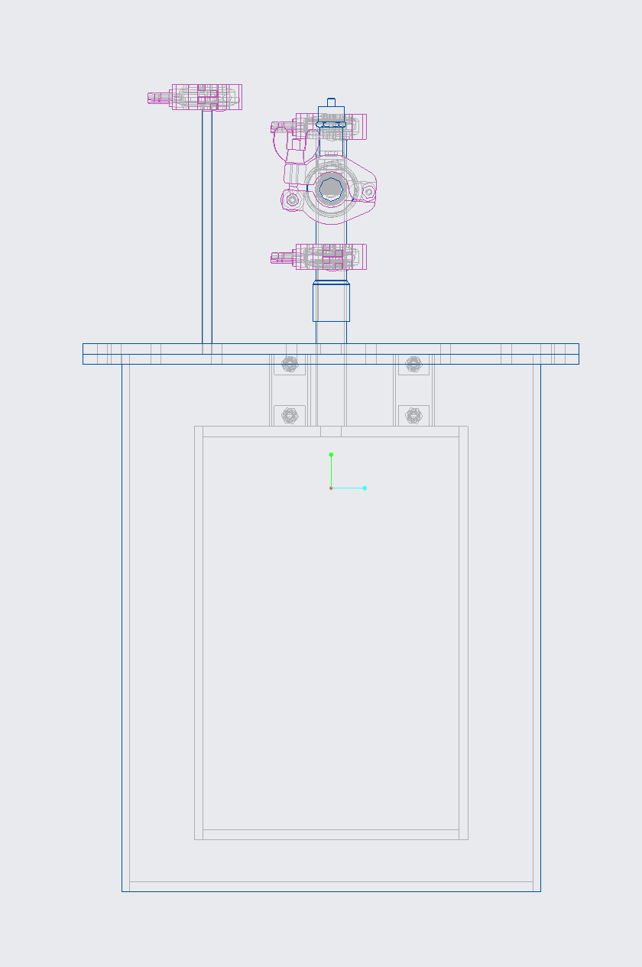
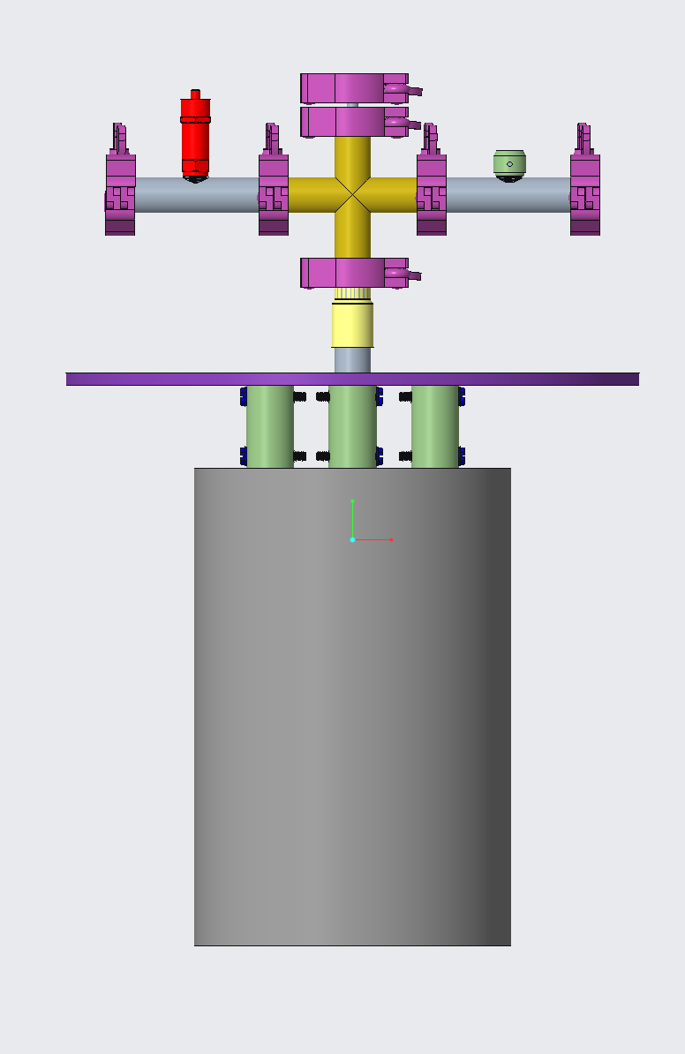

Slide 32
Customer Needs
How long will the container be in space?
What type of fuel will be stored?
What conditions are we designing for?
What scale should be used?
Either liquid hydrogen or oxygen will be used.
The container must operate under all possible conditions.
It should be scalable to contain the required amount of fluid.
Select a hypothetical mission.
Anna Gilliard
Notes:
Next, we obtained our customer needs by asking our sponsor questions and interpreting their answers.
When asked how long we should design for the container be in space, NASA left our project relatively open ended, so we decided to design for a hypothetical mission to determine the duration.
The type of fuel that will be used in practice is either liquid hydrogen or liquid oxygen. These are the most common fuel types used in an RL10 engine. The RL10 engine is one of the commonly used for spacecraft at NASA.
We are designing for all possible conditions that the container could be under. In our case, this includes conditions on Earth, during the launch of the rocket, and in space. We must also account for the tank being filled and emptied. With the fluids being at such low temperatures, the material will expand and contract to some degree, so we need to ensure that the material we choose will not be subject to failure.
Finally, we need our prototype to scale to hold the required amount of propellant.

Slide 33
Customer Needs
Team Question | Provided Answer | Interpreted Need
Are we expected to fabricate the storage container? | Yes, prototype a scaled model. | The prototype has the ability to scale to a larger size.
What improvements can be made to current products? | Extend the amount of time the fuel can be stored. | The container has the ability to increase time maintained at cryogenic temperature and pressure.
Are we expected to perform experiments and present data to validate our design? | Yes, prototyping and testing are the main goal NASA has for this project. | The system has the ability to be validated for scientific calculations and design choices.
How long will the container be in space? | This factor is up to the group. | The system has the capability to be used on a hypothetical mission of a determined length.
Does NASA have a previous model that the group can improve? | NASA wants to see original ideas. It would be best to start from scratch. | The system has the capability to store cryogenic propellant with different materials and systems than previous models.
What type of fuel will be stored? | Liquid hydrogen or liquid oxygen. | Cryogenic container has the ability to hold liquid hydrogen or liquid oxygen and maintain them at the appropriate temperature and pressure.
What would be considered a successful project? | Improve how the container handles outside heat sources. | The container has the ability to decrease the rate of heat transfer more significantly in comparison to current state-of-the-art.
Are we designing for Earth, Mars, or the moon? | This factor is up to the group. | The cryogenic tank has the ability to store the propellant properly for the mission that the team decides to design for.
Does our design have to mount onto the ship in a certain way? | The storage container should work with existing state-of-the-art support structures. | Container has the ability to connect with other parts of the ship for structure.

Slide 34
Functional Decomposition
In-Space Cryogenic Propellant Storage Container
Samantha Myers
Notes:
From our background research, assumptions, and customer needs, we broke down the project into major and minor functions.

Slide 35
Functional Decomposition
In-Space Cryogenic Propellant Storage Container
Communicates to User
Stores
Insulates
Connects
Samantha Myers
Notes:
The main functions of our in-space cryogenic propellant storage container are to store the cryogen, insulate it from heat transfer, communicate to the user, and to be able to physically connect.

Slide 36
Functional Decomposition
Stores
Hold Cryogenic Fluid
Prevent Fuel Loss
Maintains Pressure
Samantha Myers
Notes:
The first main function is to store the fuel. To successfully store the cryogen, the container must prevent fuel loss, maintain a desired pressure, and contain the fluid.

Slide 37
Functional Decomposition
In-Space Cryogenic Propellant Storage Container
Communicates to User
Stores
Insulates
Connects
Samantha Myers
Notes:
The second major function to break down is insulation.

Slide 38
Functional Decomposition
Insulates
Decrease Heat Absorption
Increase Heat Loss
Samantha Myers
Notes:
In order to successfully insulate the propellant, the storage must increase heat loss from the system and decrease heat absorption into the system.

Slide 39
Functional Decomposition
In-Space Cryogenic Propellant Storage Container
Communicates to User
Stores
Insulates
Connects
Samantha Myers
Notes:
The third major function to break down is communicating to the user.

Slide 40
Functional Decomposition
Communicates to User
Displays on Container
Sends Information
Samantha Myers
Notes:
To successfully communicate to the user, the container must send information and display the information on the container.

Slide 41
Functional Decomposition
In-Space Cryogenic Propellant Storage Container
Insulates
Communicates to User
Connects
Stores
Samantha Myers
Notes:
The last major function of the storage container is to physically connect.

Slide 42
Functional Decomposition
Connects
Attaches to Interior of Spacecraft
Attaches Inner and Outer Shell
Samantha Myers
Notes:
To successfully connect, the storage must be attachable to the spacecraft, meaning some type of hole or way to attach struts or other connectors. It must also connect the inner and outer shells of the double-shell tank, ideally with minimal conduction.

Slide 43
Functional Decomposition
In-Space Cryogenic Storage Container
Stores
Communicates with User
Connects
Insulates
Holds cryogenic fluid without failure
Maintains pressure
Prevents fuel loss
Increases pressure
Decreases pressure
Minimize heat transfer
Reduce heat absorption through radiation
Reduce heat transfer through conduction
Sends information
Displays information
Attaches to interior of spacecraft
Attaches inner and outer shell
Connects metal
Connects tubes

Slide 44
Concept Selection
House of Quality
Pugh Chart
Analytical Hierarchy Process
Name
Summary
Design Update
Testing
Timeline

Slide 45



Functions and Targets
Stores
Insulates
Connects
Samantha Myers
Summary
Design Update
Testing
Timeline

Slide 46




Targets and Metrics
Withstand 6 Gs of force
Maintain structural integrity for two weeks
Maintain pressure of 80 – 90 psi
Less than 1% mass boil off per day
Brandon Young
Summary
Targets and Metrics
Concept Generation
Concept Selection
Future Work

Slide 47


Targets and Metrics
Reflect all but 10 kJ of energy per square meter per day
Brandon Young
Summary
Targets and Metrics
Concept Generation
Concept Selection
Future Work
Notes:
Deleted: Inner shell receives less than 10 kJ of energy per day

Slide 48

Targets and Metrics
Information display synced to instruments to an accuracy of 1 second
Minimum 300 nit display, and14-point font size
Gauges or dials are clear and easy to read
If the shells become brittle, the user will be alerted with a 80 decibel alarm
If the container leaks, the user will be alerted within 5 seconds with a 80 decibel alarm
Brandon Young
Summary
Targets and Metrics
Concept Generation
Concept Selection
Future Work
Notes:
If the shells become brittle, the user will be alerted with a 80 decibel alarm
If the container leaks, the user will be alerted within 5 seconds with a 80 decibel alarm

Slide 49

Targets and Metrics
Tank is fixed on inner walls of spaceship
Inner struts withstand 6 Gs of force
Useable for up to 5 missions
Brandon Young
Summary
Targets and Metrics
Concept Generation
Concept Selection
Future Work

Slide 50
Critical Targets and Metrics
Withstand 6 Gs of Force
Maintain structural integrity for two weeks
Maintain pressure of 80 – 90 psi
Reflect all but 10kJ of energy per square meter per day
Brandon Young
Summary
Targets and Metrics
Concept Generation
Concept Selection
Future Work

Slide 51
Targets and Metrics
Function | Target
Holds cryogenic fluid without failure | Withstand 3 Gs of force on takeoff Maintain structural integrity for two weeks
Maintains pressure | Keep pressure between 80 and 90 psi for entire mission
Prevents fuel loss | Less than 1% per day mass boil off for the duration of the mission
Increases heat dissipated | Dispel all but 10 kJ of energy per unit volume per day
Decreases heat transfer | Inner tank will be subject to less than 10 kJ of energy per day
Communicate to user | Information display synchronized to instruments to the accuracy of a second
Displays on container | Digital presentation: at least 300 nit displays, 14-point font size or larger Analog Presentation: Gauges or dials clear and easy to read
Attaches to space craft interior | Attaching brackets can withstand 3 Gs of force upon takeoff Tank is fixed on inner walls of spaceship
Attaches inner and outer shell | Inner Struts can withstand 3 Gs of force on takeoff Useable for up to five missions If the storage container leaks, alerts user within 5 seconds with 80 decibels If metal becomes too brittle alert user with 80 decibels

Slide 52
Concept Generation
Morphological Chart
Geometry | Number of Layers | Thickness | Insulation
Cylinder | One | Thick | Coolant
Sphere | Two | Thin | Vacuum
Pill | Three |  | Foam
 |  |  | Powder
 |  |  | Fiber
 |  |  | Multi-layer

Slide 53

Concept Generation
Brainstorming
Liam McConnell
Summary
Targets and Metrics
Concept Generation
Concept Selection
Future Work
Notes:
Brainstorming – coming up with random ideas
Morphological chart – using a chart to combine basic ideas into more complex ideas
Biomimicry – Looking at nature for inspiration on insulation and shape

Slide 54
Concept Generation
Brainstorming
 | A | B | C
A | A | AB | AC
B | AB | B | BC
C | AC | BC | C
Morphological Chart
Liam McConnell
Summary
Targets and Metrics
Concept Generation
Concept Selection
Future Work
Notes:
Brainstorming – coming up with random ideas
Morphological chart – using a chart to combine basic ideas into more complex ideas
Biomimicry – Looking at nature for inspiration on insulation and shape

Slide 55

Concept Generation
Brainstorming
Morphological Chart
Biomimicry
Liam McConnell
Summary
Targets and Metrics
Concept Generation
Concept Selection
Future Work
Notes:
Brainstorming – coming up with random ideas
Morphological chart – using a chart to combine basic ideas into more complex ideas
Biomimicry – Looking at nature for inspiration on insulation and shape

Slide 56

Concept Generation
Double-Shell with Glass Bead Insulation
Triple-Shell with Vacuum
Double-Shell with Foam Insulation
Double-Shell Tank with Vacuum
Pill Shape with Powder Insulation
Anna Gilliard
Summary
Design Update
Testing
Timeline
Validation

Slide 57
House of Quality
Time
Safety
Surface Area
Volume
Durability
Ease of Use
Cost
Liam McConnell
Summary
Targets and Metrics
Concept Generation
Concept Selection
Future Work
Notes:
Compares customer needs to characteristics

Slide 58
House of Quality
Time
Safety
Volume
Liam McConnell
Summary
Targets and Metrics
Concept Generation
Concept Selection
Future Work

Slide 59
Pugh Charts
MLI
Foam Insulation
Spherical Shape
Double-Shell Vacuum
Powder Insulation
Glass Bead Insulation
Film Insulation
Liam McConnell
Summary
Targets and Metrics
Concept Generation
Concept Selection
Future Work
Notes:
Compares concepts to engineering characteristics

Slide 60
Pugh Charts
MLI
Powder Insulation
Foam Insulation
Liam McConnell
Summary
Targets and Metrics
Concept Generation
Concept Selection
Future Work

Slide 61
Analytical Hierarchy Process
Time
Safety
Surface Area
Volume
Durability
Ease of Use
Cost
Liam McConnell
Summary
Targets and Metrics
Concept Generation
Concept Selection
Future Work
Notes:
MLI, Ceramic supports, reflective film
Compares engineering characteristics vs themselves

Slide 62
Analytical Hierarchy Process
Time
Safety
Volume
Liam McConnell
Summary
Targets and Metrics
Concept Generation
Concept Selection
Future Work
Notes:
MLI, Ceramic supports, reflective film

Slide 63
Analytical Hierarchy Process
Time
Safety
Volume
Design Rank | Design | Normalized Score
1 | Multi-Layer Insulation | 0.444
2 | Foam Insulation | 0.283
3 | Powder Insulation | 0.274
Liam McConnell
Summary
Targets and Metrics
Concept Generation
Concept Selection
Future Work

Slide 64
Concept Selection
Binary Comparison Chart
 | 1 | 2 | 3 | 4 | 5 | 6 | 7 | 8 | Total
1 | - | 1 | 1 | 1 | 1 | 1 | 1 | 1 | 7
2 | 0 | - | 1 | 0 | 0 | 0 | 0 | 0 | 1
3 | 0 | 0 | - | 0 | 0 | 1 | 1 | 0 | 2
4 | 0 | 1 | 1 | - | 0 | 0 | 0 | 0 | 2
5 | 0 | 1 | 1 | 1 | - | 1 | 1 | 1 | 6
6 | 0 | 1 | 0 | 1 | 0 | - | 1 | 1 | 4
7 | 0 | 1 | 0 | 1 | 0 | 0 | - | 1 | 3
8 | 0 | 1 | 1 | 1 | 0 | 0 | 0 | - | 3

Slide 65
Concept Selection
1 – Increase Storage Time | a – Volume
2 – Validate Design Choices | b – Surface Area
3 – Use of Hypothetical Mission | c – Time
4 – Store Cryogenic Propellant | d – Safety
5 – Maintain Temperature | e – Durability
6 – Maintain Pressure | f – Ease of Use
7 – Reduce Heat Transfer | g - Cost
8 – Connect to Existing Systems

Slide 66
Concept Selection
A – MLI in a Vacuum, Pill Shape | E – Powder Insulation – Pill Shape
B – Foam Insulation – Pill shape | F – Spherical Shape
C – Film Insulation – Pill Shape | G – Glass Bead Insulation – Pill Shape
D – Double Shell Vacuum – Pill Shape

Slide 67
Concept Selection

Slide 68
Concept Selection

Slide 69
Concept Selection

Slide 70
Concept Selection

Slide 71
Concept Selection

Slide 72
Concept Selection
Concept | Alternative Value | Rank
MLI - Pill Shape | 0.444 | 1
Foam Insulation - Pill Shape | 0.283 | 2
Powder Insulation Supports | 0.274 | 3

Slide 73
Heat Leak Calculations
Prototype with MLI and Vacuum
Q_{rad} [W] | 1.3453
Q_{cond_pipe} [W] | 4.3241
Q_{cond_G10} [W] | 1.6904
Q_{total} [W] | 7.3598
Mass flow rate [kg/hr] | 0.1325
Time [hr] | 32.994
Time [day] | 1.3747
Liam McConnell
Summary
Design Update
Testing
Timeline
Validation

Slide 74
Calculations
Radiation (Q_{rad}= 0.5*e*As*sigma*(T₁⁴ – T₂⁴))
e | 0.075
As (m^2) | 0.192186712
sigma (W/m^2K^4) | 5.67E-08
T1 (K) | 300
T2 (K) | 77
Q_dot_rad (W) | 3.295594838

Slide 75
Calculations
Conduction (Q_{cond}= k*Ac*(T1-T2)/L) *PER SUPPORT*
k (W/m*K) | 0.228
Ac (m^2) | 0.000475
T1 (K) | 300
T2 (K) | 77
L (m) | 0.0428625
Q_dot_cond (W) | 0.563450569
number of supports | 3
Q_dot_cond_tot (W) | 1.690351706

Slide 76
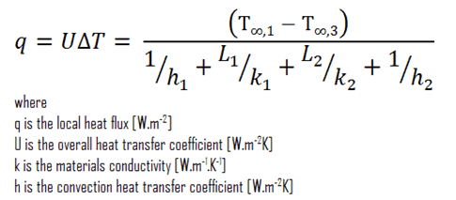
Calculations
Foam Heat Leak with Vacuum
T1 [K] | 300
T3 [K] | 77
k1 [W/mK] | 16
L1 | 0.125
k2 [W/mK] | 0.04
L2 | 1.375
q [W/m2] | 6.485798682
Surface Area [m2] | 0.192186712
Q [W] | 1.246484323

Slide 77
Heat Leak Calculations
Prototype without Insulation
Q_{rad} [W] | 3.2956
Q_{cond_pipe} [W] | 4.3241
Q_{cond_G10} [W] | 1.6904
Q_{total} [W] | 9.3101
Mass flow rate [kg/hr] | 0.1676
Time [hr] | 26.082
Time [day] | 1.0867
Liam McConnell
Summary
Design Update
Testing
Timeline
Validation

Slide 78
Heat Leak Calculations
Prototype with Foam and Vacuum
Q_{rad} [W] | 1.2465
Q_{cond_pipe} [W] | 4.3241
Q_{cond_G10} [W] | 1.6904
Q_{total} [W] | 7.2609
Mass flow rate [kg/hr] | 0.1307
Time [hr] | 33.443
Time [day] | 1.3934
Liam McConnell
Summary
Design Update
Testing
Timeline
Validation

